Slide 1
E voting system presentation

Slide 2
TEAM MEMBERS
Sameeksha gupta (0827IT151099)
Shivani ojha (0827IT151105)
Shobhit shrivastav (0827IT151106)
Yatharth Rathore (0827it151125)
Guide : Gaurav mandoli sir

Slide 3
CONTENTS
Abstract
Problem definition
Project description
Objective
Existing model
Working
Applications
Module details
Advantages
Conclusion

Slide 4
Abstract
The Project is developed for the threat free and user oriented Online Voting System. The Online Voting system is made for the people of the country residing around the world and wants to vote for their representative. The election can be conducted in two ways the paper ballot election and the automated ballot elections. The automated ballot elections are called the electronic voting. The online voting system is highly developed and the online polling system can be replaced by accurately and directly voting online and immediate results. The online voting system is done by the internet so it can be called the Internet Voting.

Slide 5
Introduction to the project
The purpose of this document is to specify software requirements of the Online Voting System.
It is intended to be a complete specification of what functionality the Voting process provides.
The purpose of this document is to give a complete description about how online voting system can be developed.
Specific design and implementation details will be specified in a future document.

Slide 6
Statement of problem
The existing system is not user friendly because the retrieval and storing of data is slow and data is not maintained efficiently.
There is a lot of paper work involved.
The voter itself has to wait in a long queue waiting for his turn to vote and consumes a long time.
But this is a web application i.e. it is a website which can be accessible from anywhere with the use of Internet.

Slide 7
Existing model
Problems faced in existing system are:
Expensive and Time consuming:-The process of collecting data and entering this data into the database takes too much time and is expensive to conduct.
Too much paper work:-The process involves too much paper work and paper storage which is difficult as papers becomes bulky with the population size.
Errors during data entry:-Errors are part of all human beings; it is very unlikely for humans to be 100 percent efficiency in data entry.
Loss of Registration forms:-Sometimes, registration forms get lost after being filled in with voters' details, in most cases these are difficult to follow up and therefore many remain unregistered.

Slide 8
Applications
This website is useful for all the users for a network with all services and features .
The application can further be enhanced by building mobile apps and much more for more convenience.
The web application can also be used for advertising.
This application will provide the upgrade from the old voting system to the new web application with lots of features for the faculties.

Slide 9
Module Details

Slide 10
Languages or Technology used for the implementation
Language Used: Java (Jdk 1.7)
Database Used: MYSQL Query Browser
IDE Used: NetBeans 7.1
JSP (Java Server Pages)

Slide 11
Description of IDE Used
NetBeans 7.1
The NetBeans Platform is a generic framework for Swing applications. It provides the plumbing that before every developer had to write themselves saving state, connecting actions to menu items, toolbar items and keyboard shortcuts; windows management, and so on.
The NetBeans Platform provides all of these out of the box. You don't need to manually code these or other basic features, yourself, anymore. See what some NetBeans based applications look like. The platform does not add a lot of overhead to your application but it can save a huge amount of time and work.
The key features of NetBeans IDE are as follows:
Fast & Smart Code Editing
Easy & Efficient Project Management
Rapid User interface Development
Write bug free code
Support for Multiple Languages
Cross Platform support
Rich set of community provided Plug-in

Slide 12
Description of Third Party tool/API Used
An Application Programming Interface (API) is a protocol intended to be used as an interface by software components to communicate with each other.
An API is a library that may include specification for routines, data structures, object classes, and variables.
An API specification can take many forms, including an International Standard such as vendor documentation such as the Microsoft Windows API, the libraries of a programming language.

Slide 13
Admin
Add Candidate:- Here the admin can add the list of candidates in the election. The candidates will be added to the list only after completing the procedures.
Register Candidate: Admin can register any valid candidate to cast vote.
Add Voter:- Here the voters can be added to the database. The voters have also the privilege to check the voters list from the homepage.
Candidate list:- The list of candidates participating in the election can be seen. It includes the candidates name, party name.
e) Voters list:- Here we can view the voters list. Each constituency will be having separate voters list.

Slide 14
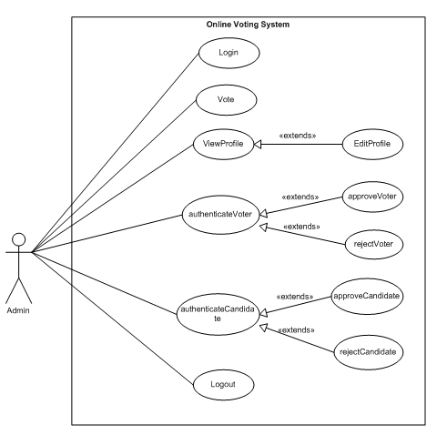
Admin use case diagram

Slide 15
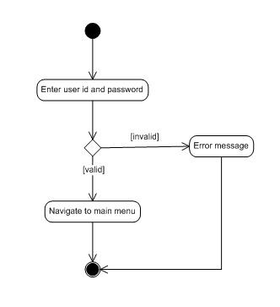
UML diagram

Slide 16
Candidates
Select Party:- The candidate can select any party to vote.
Vote :- This provides the voter with a list of candidate with in his/her party along with selection option (radio button) to select the preferred candidate from the list
View Results :-This provides graphical and user friendly representation of the votes obtained by each candidate. It includes the percentage of the votes obtained by each candidate. But the result can be viewed only after the termination date of the election.
Logout :-This provides an option for the voter to quit the session ,while in the voter home page.

Slide 17
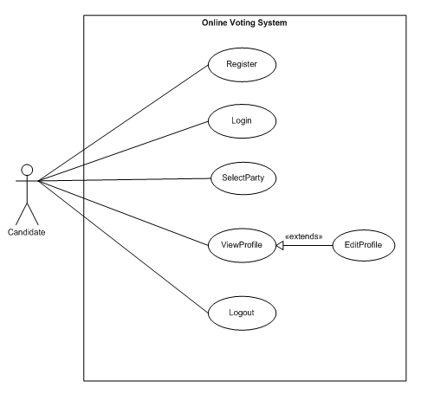
Candidate use case diagram

Slide 18
The voting protocol has five main players:
Voting Client: Present in a home, in a working station, or a polling booth.
Authorizer: The authorizer separates the identity of the user .
Counter : This part counts the encrypted votes.
Validator: It provides the proof that the voter is authorized
Database Manager: Will manage the database for all the participants.

Slide 19
Advantages
Fast and easy service.
The online voting system provides a less time consuming.
It reduces the aper work and makes the work less tedios for election commission.
It is better way for voting

Slide 20
Limitations, Restrictions and Constraints:
There are certain limitations for the implementation of the application like:-
The client computer must have suitable browser to open the application.
The server computer must have installed MYSQL Query Browser and NetBeans IDE to deploy the project.
The computer on which the system is performing tasks is equipped with a printer for printout facility.
Moreover there are limitations related to the efficient performance of the system.

Slide 21
Future scope
This project is made after thorough investigation and survey. We tried to include all the features in the project as per requirement but as this is a real world application, we have not included some of the features which can further enhanced by little bit of changes. As the requirements increase some features that can be added are:
The Online Voting System(OVS) platform can be made more secure by using the following methods
Password Changing
Fingerprinting
Cornea Detection
The password used by the user to vote is provided by the administrator. In the future the user can be given the privilege of changing the password. So it helps to increase the security of the system. The other two methods that can be used are cornea detection and fingerprinting. But here the problem is that it decreases the scope of the platform because these systems need some electronic components to implement. So it will avoid the users privilege to cast the votes at their fingertips. But it can guarantee that fake voting will be impossible.

Slide 22
Conclusion
By doing this project we were able to bring a new system for online national voting for our country. With the advent of technology and Internet in our day to day life, we were able to offer advanced voting system to voters both in the country and outside through our Online voting system.
1. Efficient and Cost Effective: The system offers significant cost benefits over paper elections in a vote to vote comparison.
2. Intelligent: The Online Voting Platform offers intelligent ballots, smart checklist features, vote tallying, tabulation and reporting.
3. Save Time and Resources: Online voting system drastically reduces the time required to set up and conduct elections.
4. Easy and convenient: The Online Voting Platform offers the easiest and most convenient method for administrators and voters alike.

Slide 23
Thank You!

